Slide 1

7th Grade Math
Unit 2, Lesson 6 Comparing Probabilities Volume 1, pg. 63

Slide 2


Benchmark
MA.7.DP.2.2
Given the probability of a chance event, interpret the likelihood of it occurring. Compare the probabilities of chance events.
volume 1, pg. 63

Slide 3
Integrated Mathematical Thinking and Reasoning Standards
MA.K12.MTR.3.1 Complete tasks with mathematical fluency.
MA.K12.MTR.7.1 Apply mathematics to real-world contexts.
volume 1, pg. 63

Slide 4

Learning Targets
I can interpret the likelihood of a chance event occurring using probability.
I can compare probabilities of chance events.
volume 1, pg. 63

Slide 5

Warm-Up
volume 1, pg. 63

Slide 6
2.6.1 Warm-Up: Statisticians Careers
Statisticians turn data into understandable and useful information. The government, health care industry, sports broadcasting, and many businesses have statisticians who analyze data to predict trends. Statisticians help businesses and industries with decision-making based on analysis.
What are some real-world examples where you have seen statistics used?
volume 1, pg. 63

Slide 7
Consider an industry you are interested in working in someday.
What industry are you considering?
What is at least one way you could see trends in data and analysis of statistics used in this industry?
volume 1, pg. 63

Slide 8

Activity
volume 1, pg. 64

Slide 9

2.6.2 Activity: Likelihood of Chance Events
Work with your partner or group to order the events on the cards from least likely to most likely.
After ordering the events, work with your partner or group to complete the following using the events from the card sort.
Explain which event(s), if any, can be described as “impossible.”
Explain which event(s), if any, can be described as “certain.”
volume 1, pg. 64

Slide 10
Explain which event(s), if any, can be described as “equally likely as not.”
Express the likelihood of a randomly chosen word in a novel beginning with the letter T, as a percentage.
Express the likelihood of a randomly selected person being left-handed, as a decimal.
volume 1, pg. 64

Slide 11

Guided Practice
volume 1, pg. 64

Slide 12

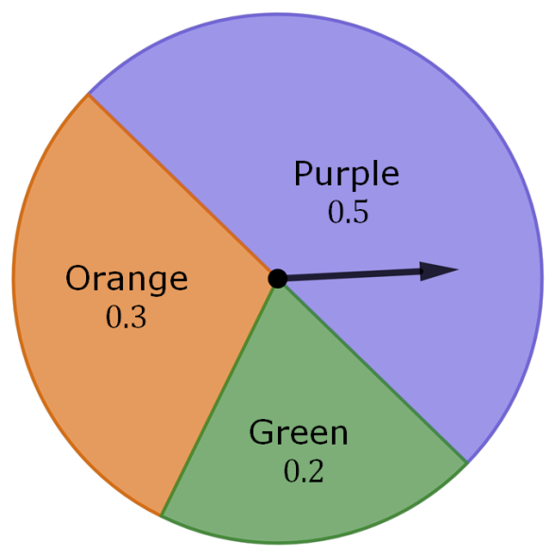
2.6.3 Guided Practice: Interpreting and Comparing Probabilities
A spinner is shown with the probabilities of landing on each space given as a decimal.
Use the spinner to complete the table by identifying the missing events, probabilities, and descriptions of likelihood.
volume 1, pg. 64

Slide 13
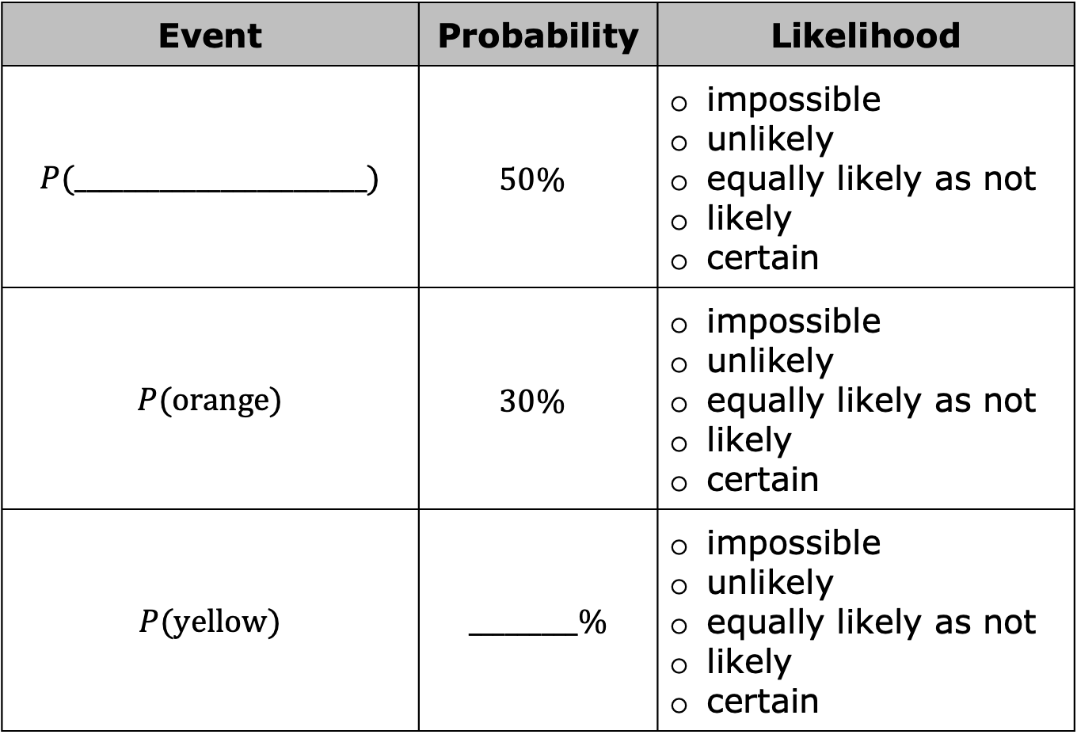
Event | Probability | Likelihood
$P$(________________________) | $$50\%$$ | impossible unlikely equally likely as not likely certain
$P$(orange) | $$30\%$$ | impossible unlikely equally likely as not likely certain
$P$(yellow) | _________% | impossible unlikely equally likely as not likely certain
volume 1, pg. 65

Slide 14

Event | Probability | Likelihood
$P$(________________________) | $$20\%$$ | impossible unlikely equally likely as not likely certain
$P$(purple or orange) | $$80\%$$ | impossible unlikely equally likely as not likely certain
$P$(color) | _________% | impossible unlikely equally likely as not likely certain
volume 1, pg. 65

Slide 15
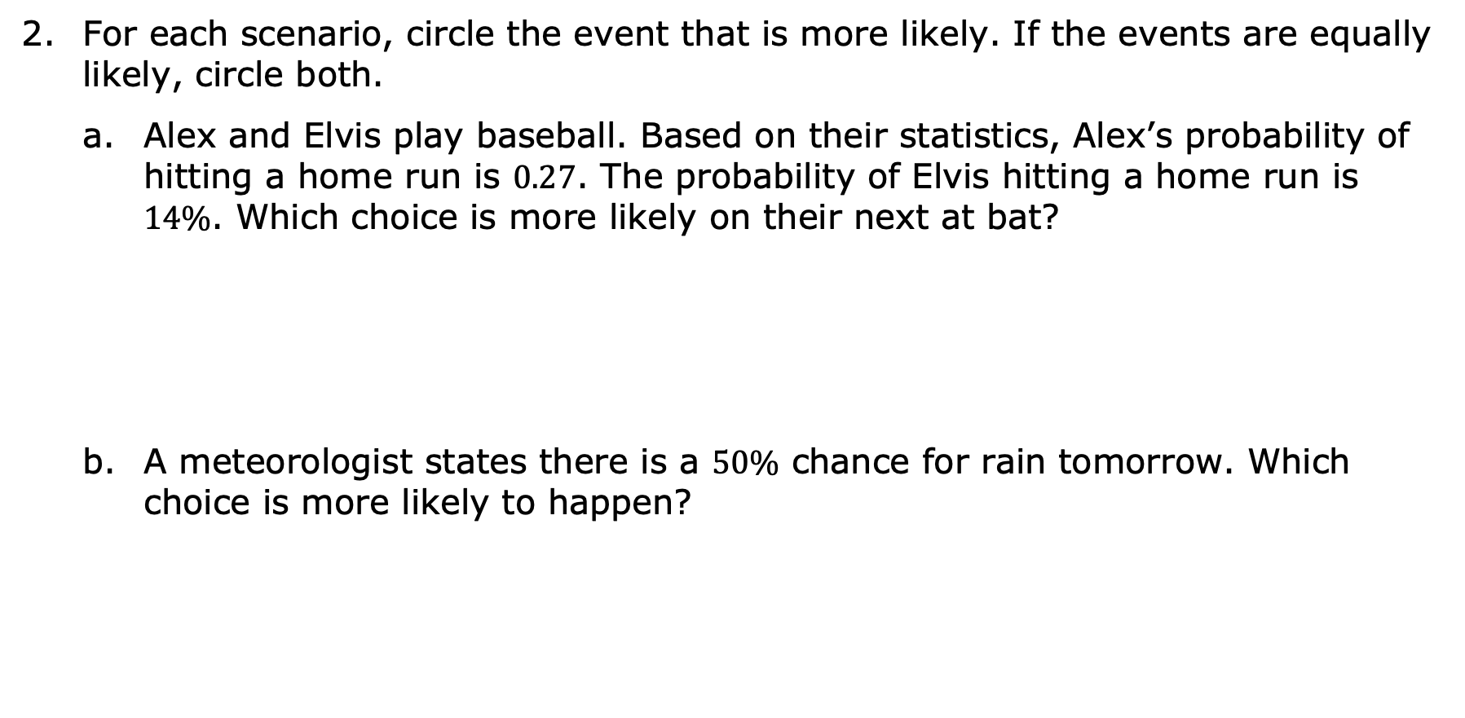
For each scenario, circle the event that is more likely. If the events are equally likely, circle both.
Alex and Elvis play baseball. Based on their statistics, Alex’s probability of hitting a home run is $0.27$. The probability of Elvis hitting a home run is $14\%$. Which choice is more likely on their next at bat?
A meteorologist states there is a $50\%$ chance for rain tomorrow. Which choice is more likely to happen?
Alex hits a home run. | or | Elvis hits a home run.
It will rain tomorrow. | or | It will not rain tomorrow.
volume 1, pg. 65

Slide 16
Shawn is calling the coin toss before his football game. Which choice is more likely to occur?
The coin will land on its edge. | or | The coin will land on either heads or tails.
volume 1, pg. 65

Slide 17

Your Turn
volume 1, pg. 66

Slide 18
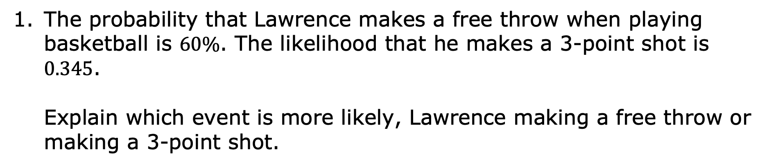
2.6.4 Your Turn!
The probability that Lawrence makes a free throw when playing basketball is $60\%$. The likelihood that he makes a 3-point shot is $0.345$.
Explain which event is more likely, Lawrence making a free throw or making a 3-point shot.
volume 1, pg. 66

Slide 19
The probabilities of five events are shown.
List the probabilities in order from least to greatest.
$$60\%$$ | $8$ out of $10$ | $$0.37$$ | $$20\%$$ | $\frac{5}{6}$
volume 1, pg. 66

Slide 20

Wrap-Up
volume 1, pg. 66

Slide 21
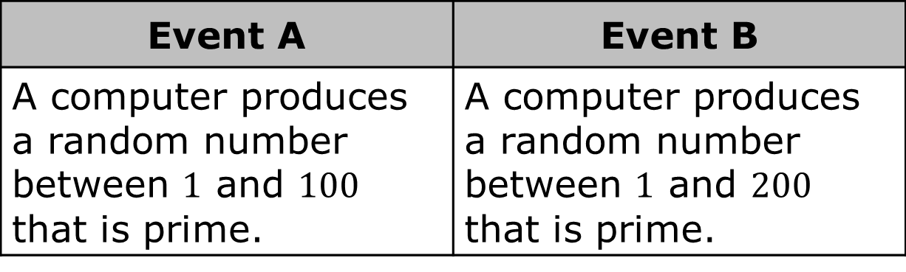
2.6.5 Wrap-Up: Ticket Out the Door
There are $25$ prime numbers between $1$ and $100$. There are $46$ prime numbers between $1$ and $200$. Two events are shown.
Event A | Event B
A computer produces a random number between $1$ and $100$ that is prime. | A computer produces a random number between $1$ and $200$ that is prime.
volume 1, pg. 66

Slide 22
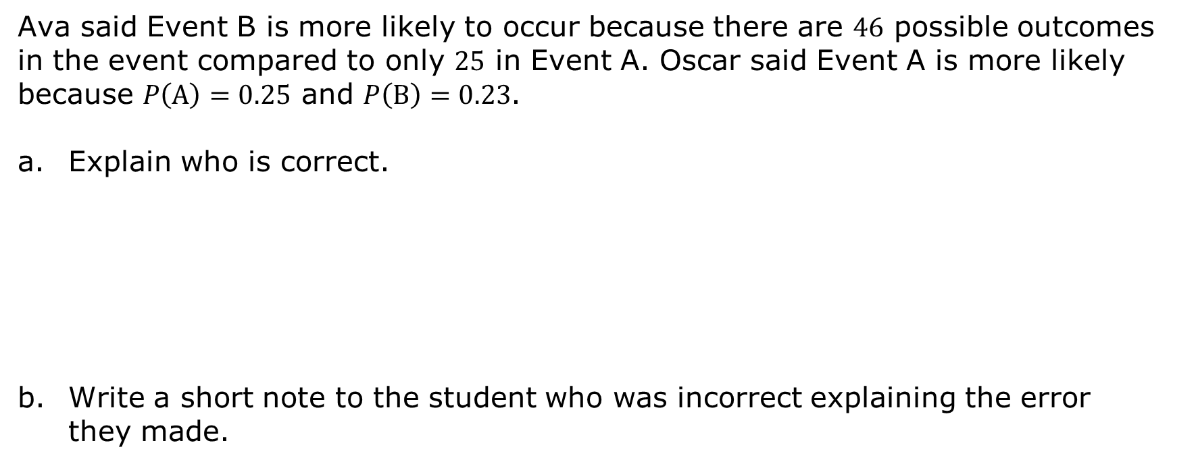
Ava said Event B is more likely to occur because there are $46$ possible outcomes in the event compared to only $25$ in Event A. Oscar said Event A is more likely because $P\left(A\right)=0.25$ and $P\left(B\right)=0.23$.
Explain who is correct.
Write a short note to the student who was incorrect explaining the error they made.
volume 1, pg. 66

